Slide 1

HELICAL ANTENNA
By
S Rakshana
Thandu Sirivalli

Slide 2

APPLICATIONS
Helical antennas are commonly used in satellite communication, GPS, and space missions due to their ability to provide circular polarization and high gain. These antennas are also used in weather satellites, remote sensing systems like SAR, and CubeSats because of their compact and efficient design. Additionally, they are employed in military communication, UAVs, and radio astronomy, where reliable, long-range, and wide-band communication is essential. Their versatility makes them valuable in various high-frequency and space-related applications.

Slide 3
ADVANTAGES
Wide bandwidth (broadband)
Simple structure
Low cost
High gain.
MODES OF OPERATION
Normal mode (broadside): Similar to radiation pattern of dipole antenna
Axial mode (end-fire): Only one major lobe (maximum intensity is along the helix axis)

Slide 4
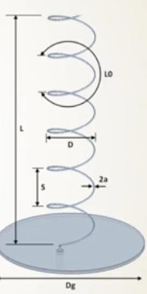
DESIGN PARAMETERS
Design of Helical Antenna (Axial Mode)
✅ Axial Mode
Pitch angle:
α=tan^⁡−1(S/C) , 0^∘≤α≤90^∘
Optimum Condition:
12∘ ≤ α ≤ 14∘
Spacing between each turn:
α=tan⁡−1(S/C)⇒S=Ctan⁡α
Total length of antenna & wire:
L0^2=S^2+C^2 , Lw=NLo , L=NS
Half-power beamwidth (HPBW):
HPBW (degrees) = (52 × λ₀³ᐟ²) / (C × √(N × S))
Source: Constantine A. Balanis, Antenna Theory: Analysis and Design, 4th Edition

Slide 5
DESIGN PARAMETERS
Design of Helical Antenna (Axial Mode)
✅ Axial Mode
• Diameter of ground plane:
Dg ≥ (3/4)λ₀
• Circumference of helix:
(3/4) < C/λ₀ < (4/3) , C/λ₀ = 1 (near optimum) , D = C / π
• Axial ratio (AR):
AR = (2N + 1) / 2N ⟹ N ≈ 1 / [2 × (AR – 1)]
Source: Constantine A. Balanis, Antenna Theory: Analysis and Design, 4th Edition

Slide 6
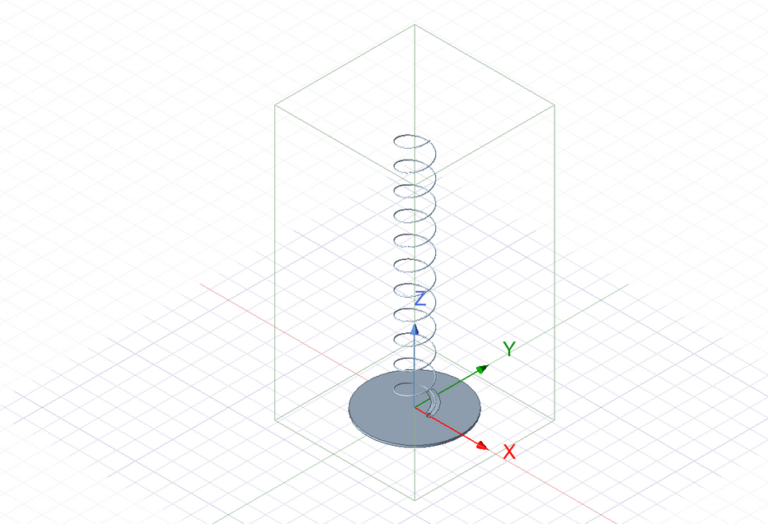
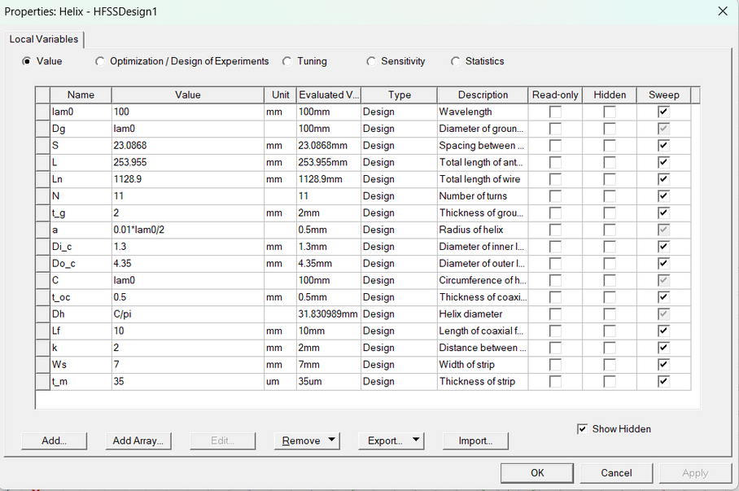
DESIGN

Slide 7
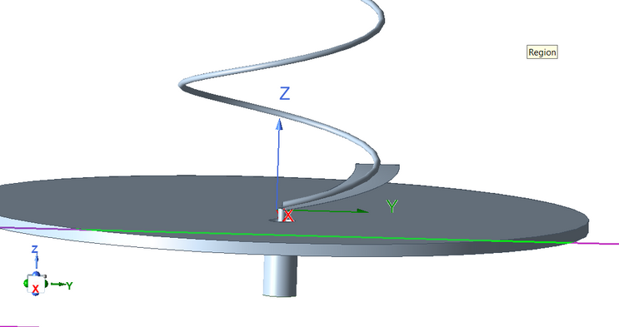
IMPEDANCE MATCHING
Tapered Impedance Matching
In helical antennas, especially in axial mode, the input impedance is typically high (around 140–200 ohms).
To match this to a standard 50-ohm feed line, the initial part of the helix is gradually tapered in radius or pitch to act as a smooth transition from 50 ohms to the helix impedance.

Slide 8
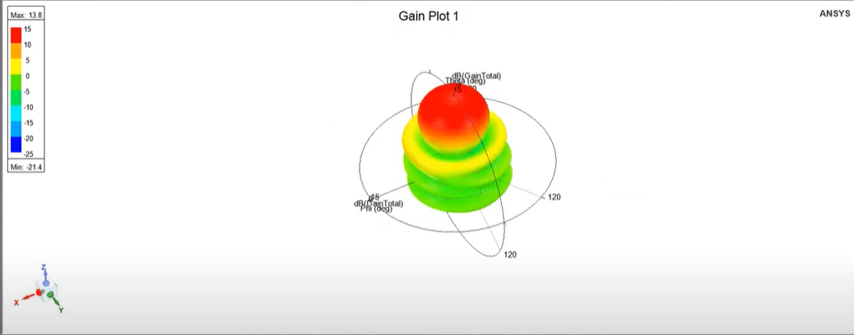
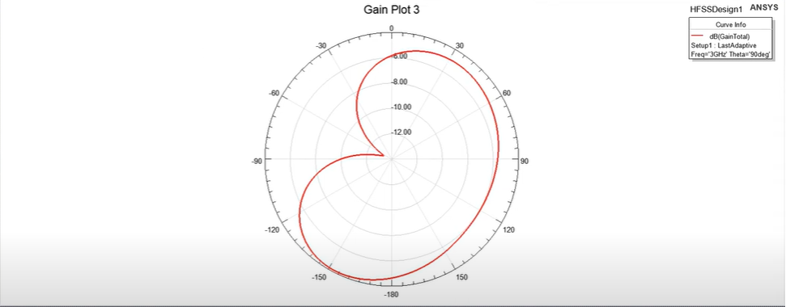
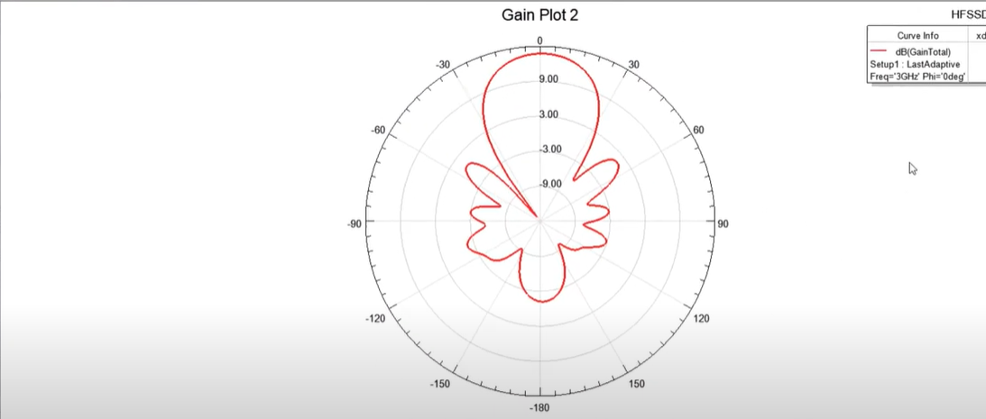
ANALYSIS

Slide 9
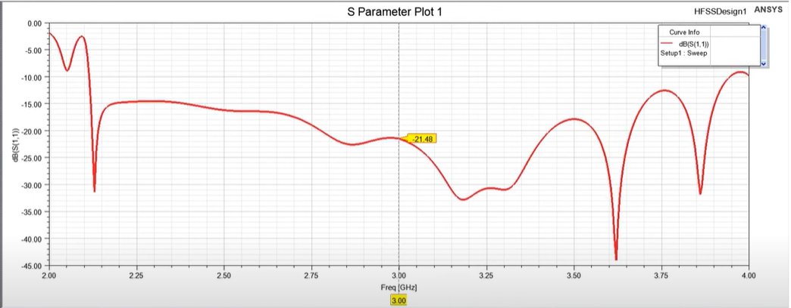
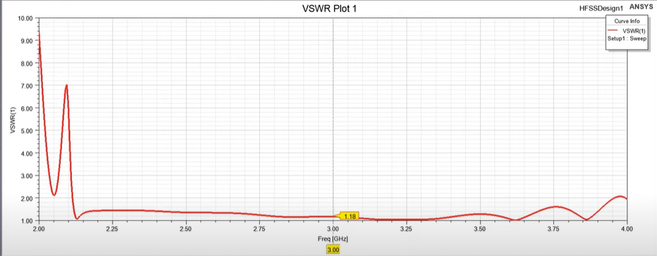
RESULT

Slide 10
CONCLUSION
Hence a Helical antenna for 3Ghz using Ansys HFSS was designed and simulated successfully

Slide 11
THANK YOU

